Slide 1
Annual Report on the IA for Co-operation on Tokamak Programmes
Tony Donné / Duarte Borba
EUROfusion
Chair / Secretary,
Executive Committee
February 12, 2020

Slide 2
Outline
Objective and scope of the CTP-TCP
Chair’s report
  Governance
  Membership
  Outreach
Highlights and milestones achieved
Future plans

Slide 3
Objective and scope of the CTP-TCP
Advance fusion science and technology by strengthening cooperation amongst tokamak programmes.
Promote exchanges related to the experimental programmes of the partner tokamak facilities
Design and planning of experiments to contribute to the database for next generation tokamak devices
  support of activities identified by the International Tokamak Physics Activity (ITPA) operating under the auspices of the ITER Organization since 2009

Slide 4
  Governance
Tony Donné (EU) is Chair of the Executive Committee from 1 March 2017 to 29 February 2020.
China will take over as Chair from 1 March 2020 onwards for a 3-year mandate.
Luo Delong (China) “Director-General at China International Nuclear Fusion Energy Program Execution Centre” will become Chair from 1st March 2020 for a period of 3 years.

Slide 5
Membership
CTP TCP has 8 Contracting Parties (CPs)
4 IEA member countries:
  Australian Nuclear Science and Technology Organisation (ANSTO), Australia
  National Institutes for Quantum and Radiological Science and Technology (QST), Japan
  Korean Ministry of Education, Science and Technology (MEST), Korea.
  United States Department of Energy (USDOE), United States
1 partner country:
  The Institute for Plasma Research (IPR), India.
3 International Organizations:
  European Atomic Energy Community (Euratom), European Union
  ITER China Domestic Agency (CNDA)
  ITER Organization

Slide 6
Membership
  CTP recognises the importance of Russia as a major partner in the ongoing collaborations. The Chair has sent a new letter of invitation to ROSATOM to join the CTP TCP, but this was never answered.
  Thailand has expressed the interest to become member of the CTP-TCP and observers from Thailand participated in the 10th Meeting of the Executive Committee: Arlee Tamman (Thailand), Thawatchai Onjun (Thailand).

Slide 7
  Outreach
Main events during 2019
  10th Executive Committee Meeting ITER HQ, France, Thursday 12th December 2019
  22nd meeting of the International Tokamak Physics Activity Coordinating Committee (ITPA CC) and 10th ITPA meeting for Joint Experiments ITER HQ, France, 10-12 December 2019
  KSTAR Conference 20-22 February 2019, Coex, Seoul, Korea
  PPPL Workshop on Theory and Simulation of Disruptions Princeton Plasma Physics Laboratory, Princeton, New Jersey 5-7 August 2019
The website http://ctp.jet.efda.org/tcp/ has been significantly upgraded, modernised and information revisited.

Slide 8





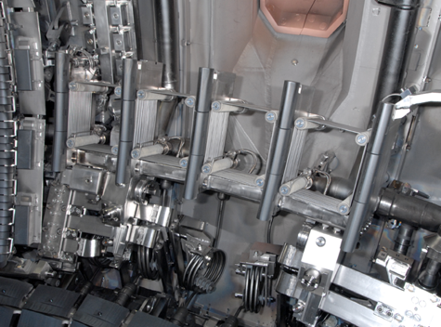
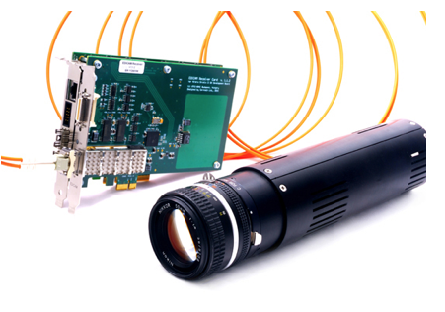
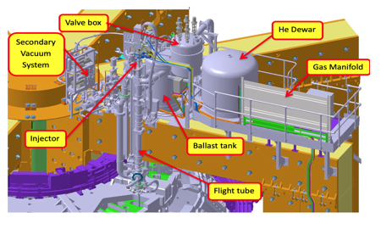
  Outreach
Three projects have been submitted to IEA regarding the Today in the Lab - Tomorrow in Energy?
  Initiative on: JET TAE Amplifier and Control Upgrade
  Event Detection Intelligent Camera (EDICAM) for the JT-60SA Tokamak
  JET Shattered Pellet Injection for Disruption Mitigation in ITER
Drawing of the JET Shattered Pellet Injection
Event Detection Intelligent Camera
JET TAE Antenna

Slide 9
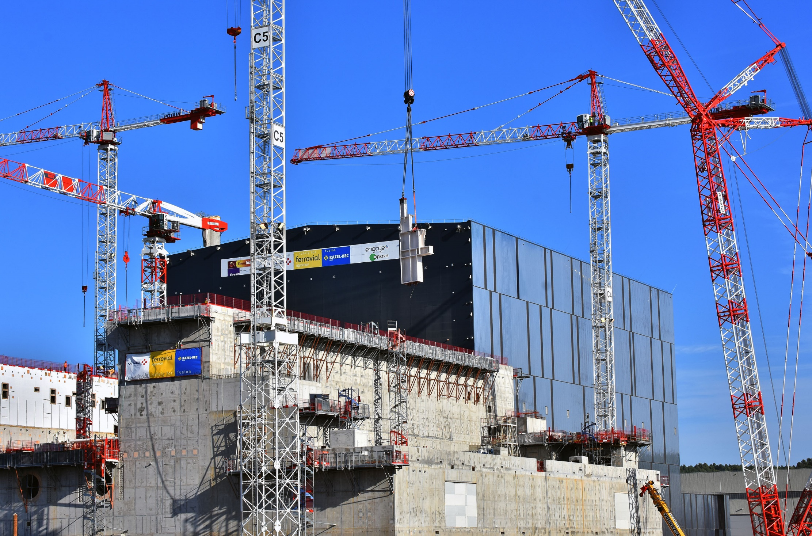
Key achievements related to new facilities
ITER: The project continued to advance well in 2019 with 73% of construction and 67% of total First Plasma scope achieved
ITER

Slide 10
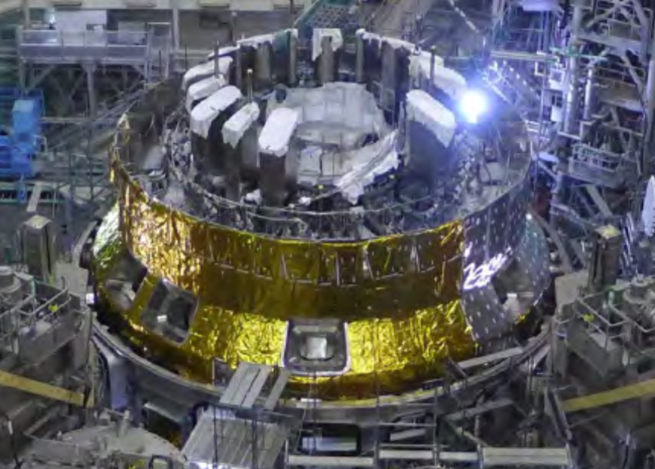
Key achievements related to new facilities
JT60-SA: The fabrication of most of the key components has been finished. Assembly of the lower part of the cryostat has been finished. Thermal shields have also been assembled.
Assembly of JT-60SA is approaching the final stage towards its completion and the start of the integrated commissioning
First plasma is foreseen in 2020.
JT60-SA

Slide 11

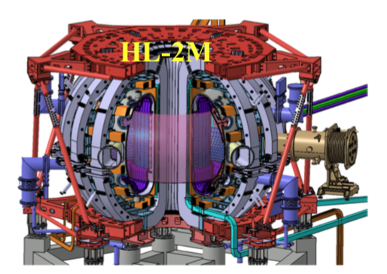
Key achievements related to new facilities
HL-2M Mission under construction to address key plasma physics issues and advanced tokamak scenario in support of future machines (ITER, CFETR)
  Plasma current Ip = 3 MA
  Major radius R = 1.78 m
  Minor radius a = 0.65 m
  Aspect ratio R/a = 2.8

Slide 12

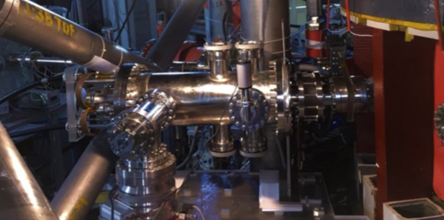
Key achievements related to new facilities
Two experimental campaigns were carried out in SST-1 in 2019 performing ECRH assisted Ohmic breakdown studies and lower hybrid current drive experiments. Several technical issues related to cryogenic heat loads has been resolved with the Toroidal Field coils tested to the highest ever field of 2.7 T.
The ADITYA-UG tokamak achieved 177 kA of plasma current at the maximum toroidal field of 1.4T. The plasma pulse duration was extended to 335 milliseconds in 2019. Experiments with an Electromagnetic Pellet Injector have been performed and 200mg pellet of Lithium Titanate particles were injected during the plasma current flat-top.
Electromagnetic Pellet Injector in Aditya-UG

Slide 13
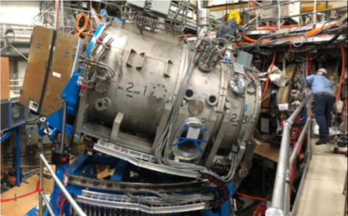
Key achievements related to new Capabilities
DIII-D Completed Long Torus Opening activities during 12-month vent period, including installation of toroidally steerable, off-axis neutral beam injector
DIII-D off-axis neutral beam

Slide 14
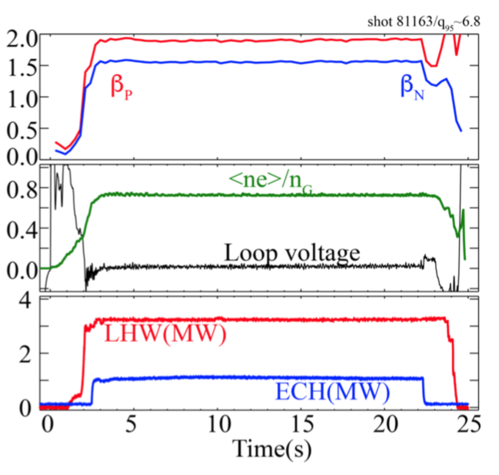
Key physics achievements
EAST steady state scenario using pure RF H&CD with good confinement, good control of impurities, small ELMs, metal wall and zero torque.

Slide 15

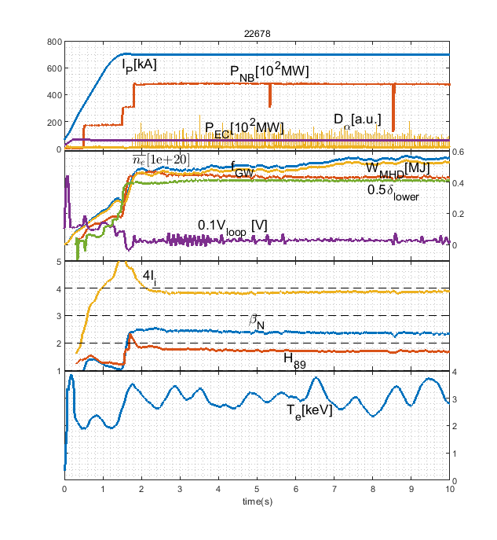
Key physics achievements
Long-pulse hybrid scenarios in KSTAR
Long-pulse hybrid scenarios were explored in pulses of up to 9 seconds
Double null plasmas were studied with significant increase in the stored energy.

Slide 16
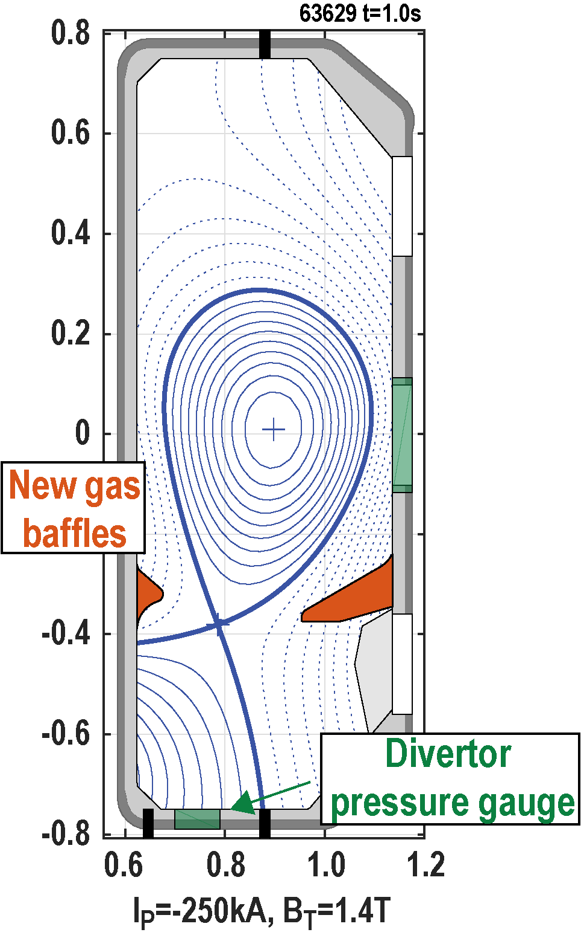
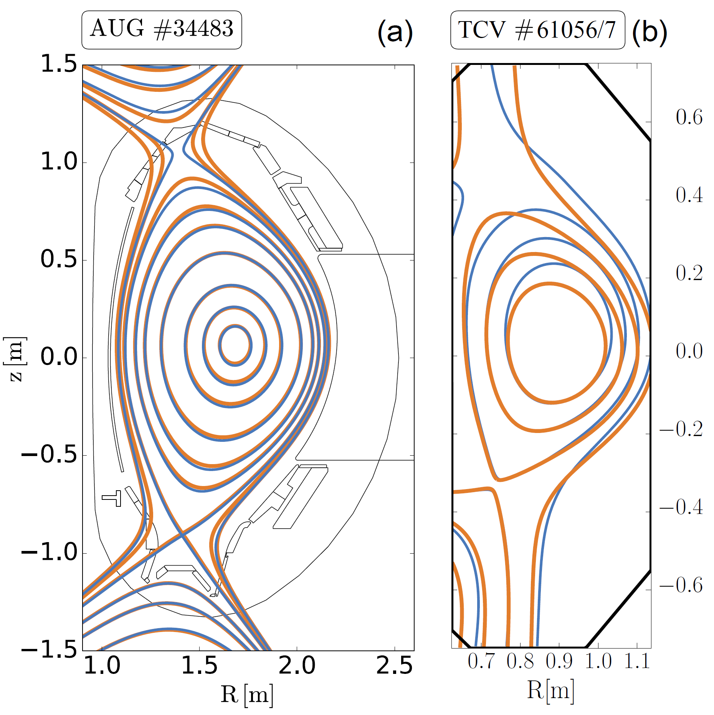

Key physics achievements
Baffled TCV divertor increases the divertor neutral pressure and extends the detached regime, confirming model predictions.
Small ELM scenarios on AUG and TCV : Importance of magnetic shear at Separatrix

Slide 17
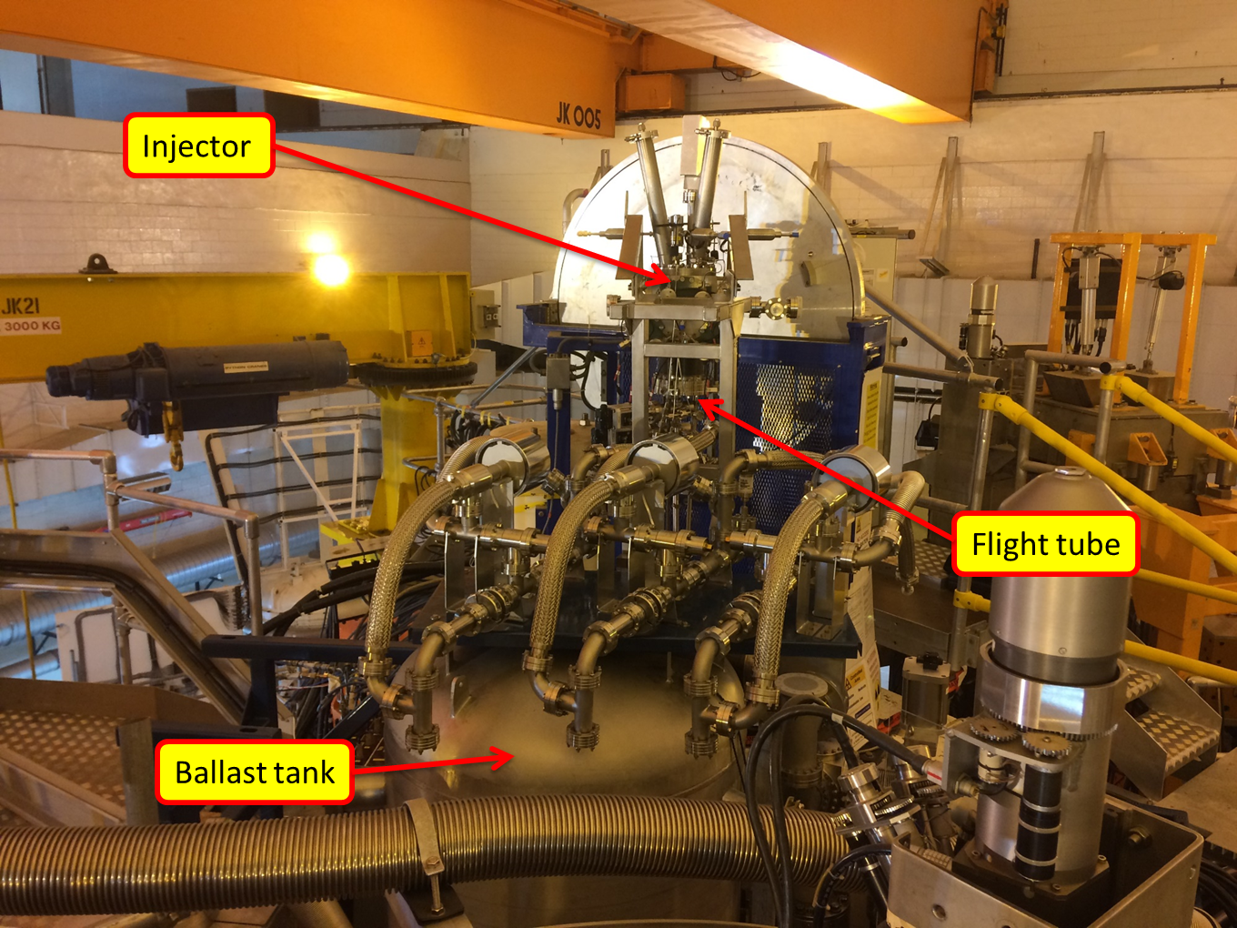
Key physics achievements
Mitigation of disruptions a critical issue for ITER
Framework agreement between 4 CTP partners to design, construct, install and operate ITER relevant hardware on JET
Successful Shattered Pellet Injection commissioning and operation on JET
  First injection in Plasma 06/07/2019
  First runaway beam mitigated with SPI on 10/09/2019
JET Shattered Pellet Injection System

Slide 18
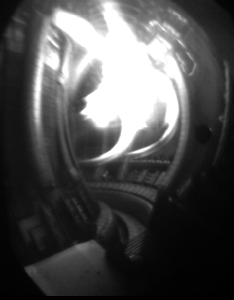
Key physics achievements
A large amount of data has already been collected for ITER with dedicated JET experiments
The results are preliminary and will require detailed analysis
Run-away suppression with shattered pellet demonstrated
Unexpected result with the 12mm D2 shattered leading to suppression of fast electrons:
Thermal load mitigated with SPI and analysis of mitigation of radiation asymmetry
Image of JET Shattered Pellet Injection mitigated disruption

Slide 19
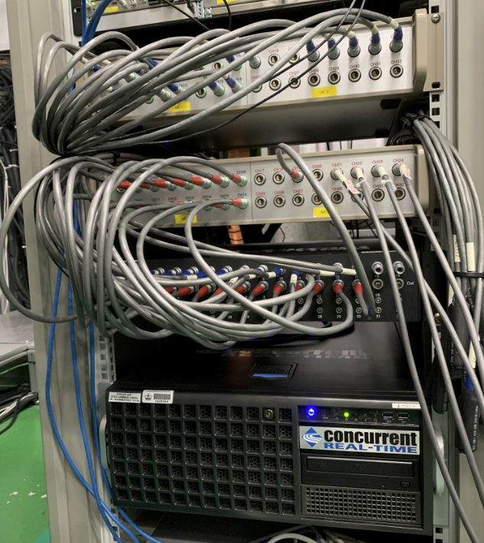
Key physics achievements
Disruption prediction and avoidance research on KSTAR is moving towards real-time applications.
  Real-time MHD analysis computer installed at NFRI
  Designed for connection to plasma control system (PCS)
  Interface to MHD probes built
S. Sabbagh, Columbia Univ

Slide 20
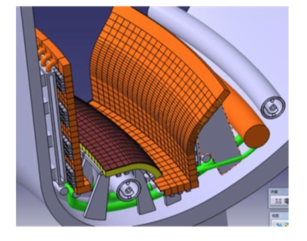
Future Plans
EAST new configuration design of W lower divertor aiming at high neutral pressure for detachment at without impurity seeding with strike point on horizontal target,
Water-cooled copper in-vessel coil facilitate the achievement of X-divertor configuration and strike point sweeping allow operation with strike point on vertical target or horizontal target

Slide 21
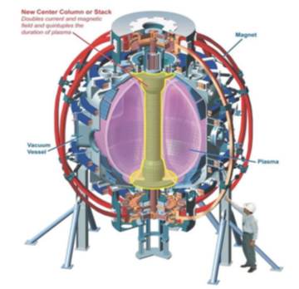
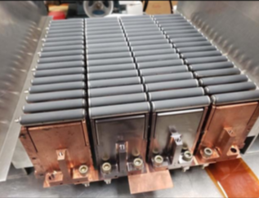
Future Plans
NSTX-U Machine reassembly is scheduled to commence in the summer of 2020. The early-finish date for the Project, followed by the resumption of operations, is May 2021.
Installation of helicon antenna on DIID-D
NSTX-U
DIII-D Helicon antenna modules

Slide 22
Additional Slides

